Slide 1
CH1 Pointer
Pointer and array

Slide 2
01
Pointer and 2D array
02
Passing arrays between functions
Table of contents
03
QA
04
HW

Slide 3

01
Pointer & 2D array

Slide 4
Address : (ptr+i) == (arr+i) == &arr[i] Value : *(ptr+i) == *(arr+i) == arr[i]
Arr[i][j] == (arr[i])[j]
== *(arr[i] + j)……
== *(arr[i] + j)
== *(*(arr + i) + j) ……
1
2

Slide 5
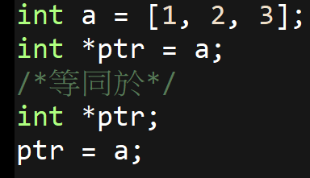
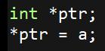
縮寫複習
☹

Slide 6
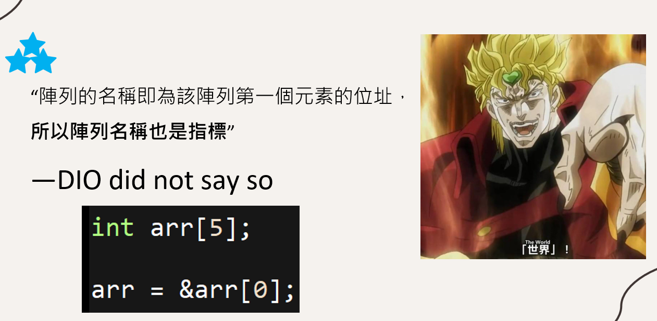
複習DIO

Slide 7
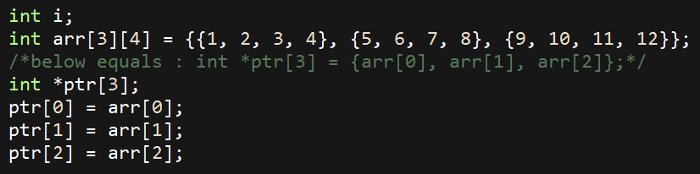
指標陣列

Slide 8
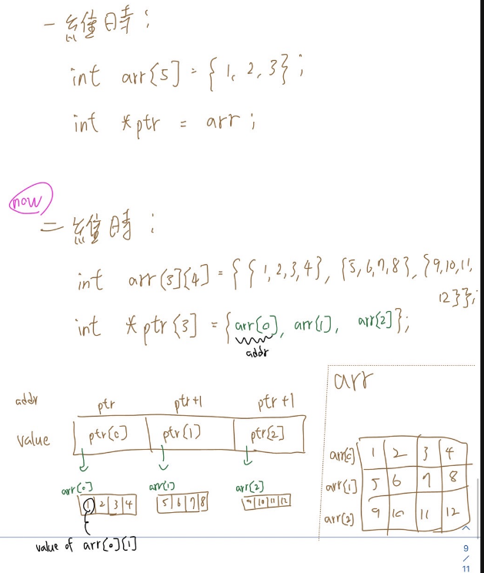

Slide 9
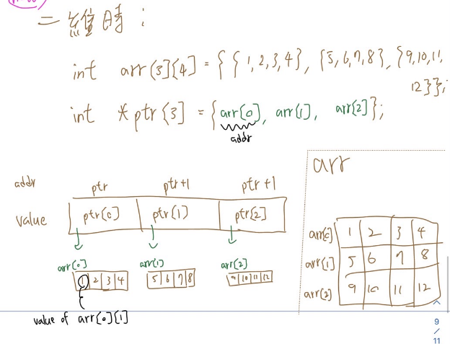
可看DEMO1
**ptr == *ptr[0] == *arr[0] == arr[0][0] == 1
**(ptr+1) == *ptr[1] == *arr[1] == arr[1][0] == 5
**(ptr+2) == *ptr[2] == *arr[2] == arr[2][0] == 9

Slide 10
demo2
Another example

Slide 11
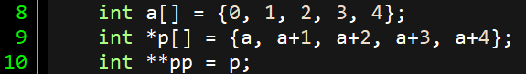
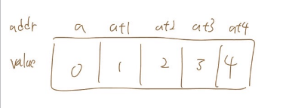

Slide 12
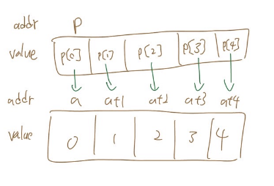

Slide 13
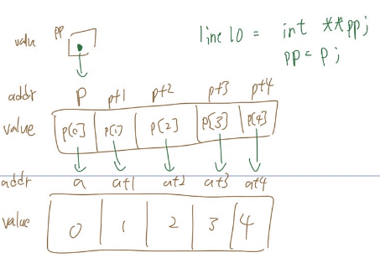

Slide 14
Us
Them
demo2
(1) pp == p
(2) *pp == p[0] == a
(3) **pp == *a == 0
(1) Pp+2 == p+2
(2) *(pp+2) == p[2] == a+2
(3) *(pp+2)+2 == (a+2)+2 = a+4
(4) *(*(pp+2)+2) == 4

Slide 15

02
Passing arrays between functions

Slide 16
Call by address
為何要用call by address?
如果用這種方式傳遞陣列的話，要傳遞那些參數呢?

Slide 17
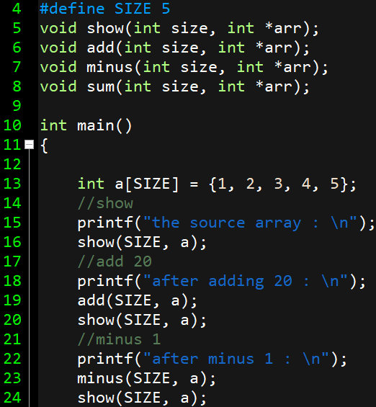

Slide 18
tips
void show(int arr[])
== void show(int *arr)
兩種宣告方式都可以，且用哪一種都可以用陣列記號和指標去存取元素

Slide 19
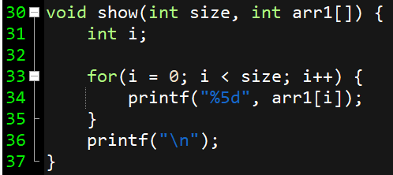

Slide 20
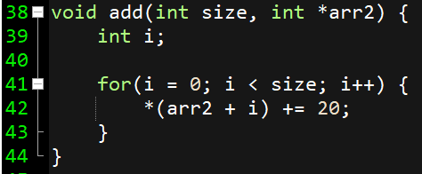

Slide 21
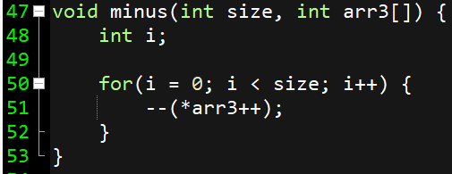
1
2

Slide 22

03 HOLY AI

Slide 23
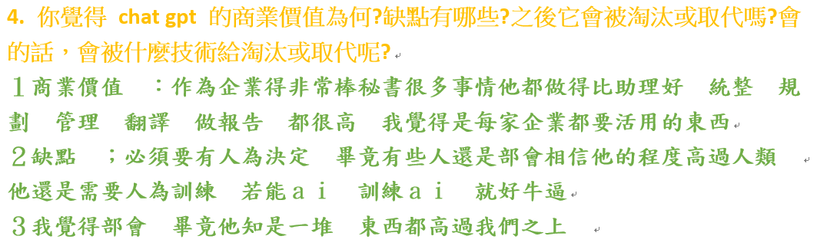

Slide 24

04
HW

Slide 25
¡Gracias!

